Slide 1
INTRODUCTION TO SDN
Primary goal of SDN
3 layer model of Operating systems(analogy for an SDN model)
3 layer SDN Model
Layer Details
Packet walkthrough example
Availability and scalability
SDN vs traditional networks
Courtesy : Software-Defined Networking: A Comprehensive Survey

Slide 2
THE BIG PICTURE

Slide 3
OPEN
PROGRAMMABLE

Slide 4
Why SDN
Traffic Engineering
Security
QoS
Routing
Switching
Virtualization
Monitoring
Load Balancing
New Innovations?

Slide 5
SDN is a solution for
High Demand on resources
Unpredictable and rapidly changing traffic pattern
Rapid network reconfiguration
Running Large Data center

Slide 6
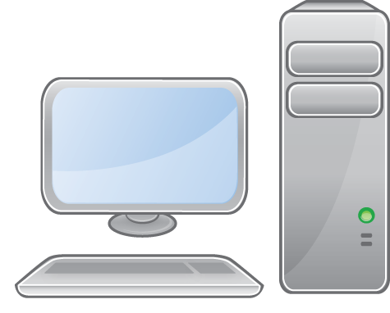
Operating System Model

Slide 7
Operating
System
CORE SERVICES

Slide 8
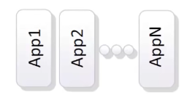
Operating
System
OS
Model
CPU
Memory
Storage
Network
Lower Levels /South of OS

Slide 9
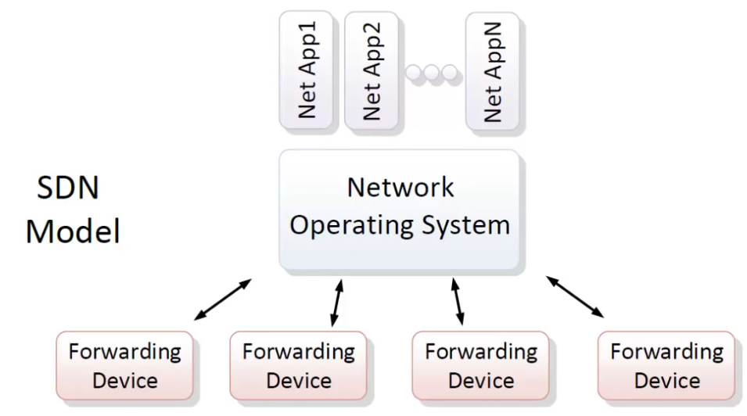


Slide 10
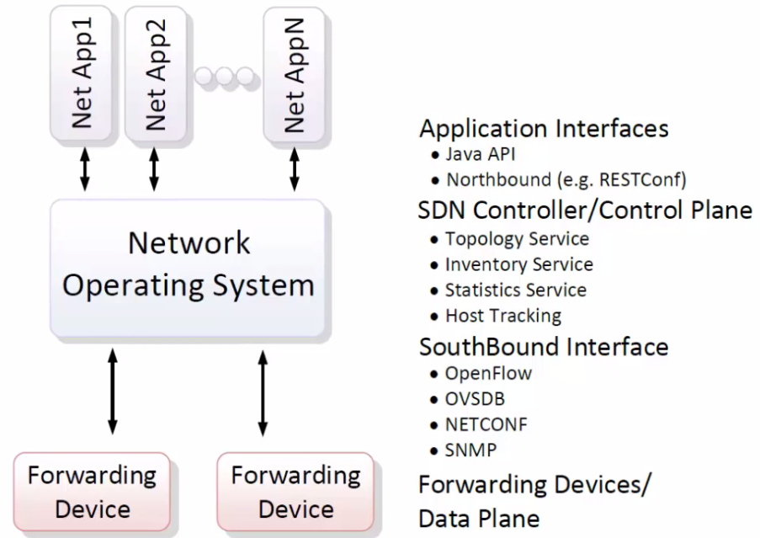
Opennetworking.org

Slide 11
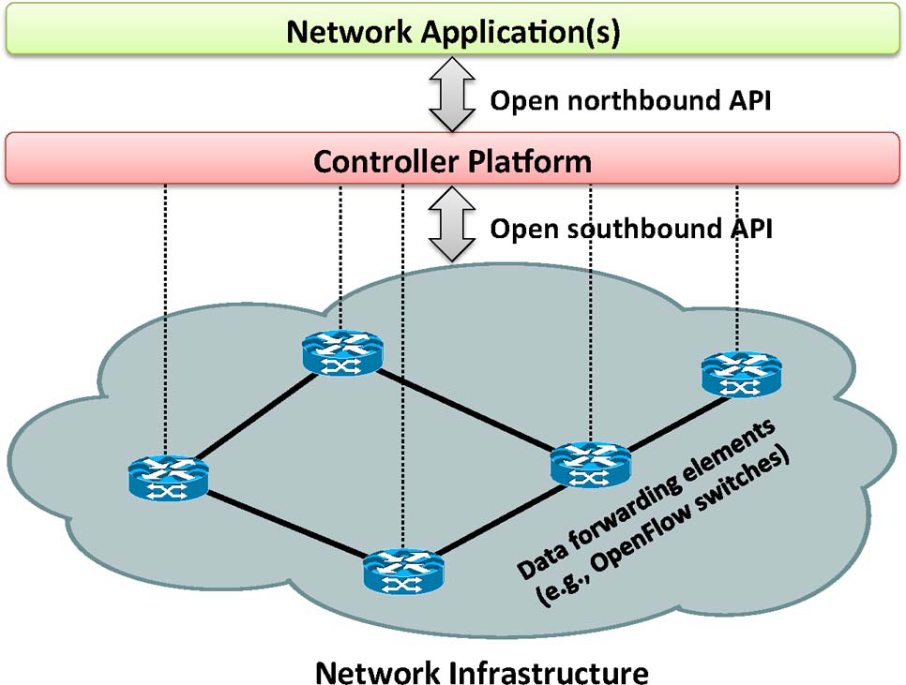
Courtesy : Software-Defined Networking: A Comprehensive Survey

Slide 12
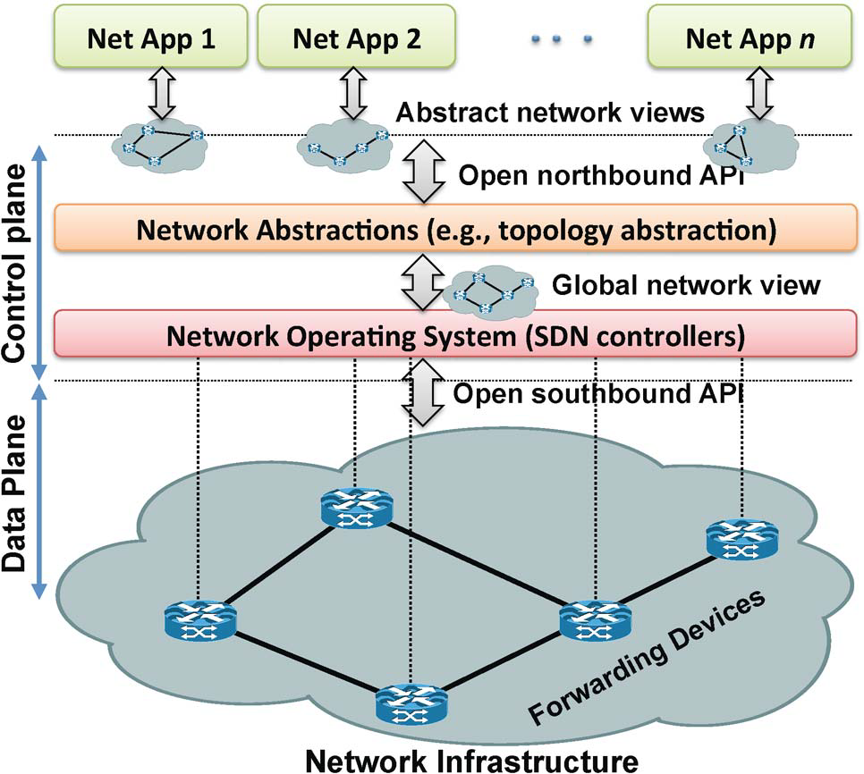
Courtesy : Software-Defined Networking: A Comprehensive Survey
SDN architecture and its fundamental abstractions.

Slide 13

Software-Defined Network with key Abstractions
Network Virtualization
Well-defined API
Application
Plane
Security
Routing
Traffic Engineering
Other Applications
Network Map
Abstraction
Control
Plane
Network Operating System
Instructions
Instructions
Instructions
Instructions
Forwarding
Separation
of Data &
Control Plane
Forwarding
Forwarding
Data
Plane
Forwarding
Courtesy : Hengky “Hank” Susanto, Sing Lab, HKUST

Slide 14
NUTSHELL
Separate Control plane and Data plane entities.
Network intelligence and state are logically centralized.
The underlying network infrastructure is abstracted from the applications.
Execute or run Control plane software on general purpose hardware.
Decouple from specific networking hardware.
Use commodity servers and switches.
Have programmable data planes.
Maintain, control and program data plane state from a central entity.
An architecture to control not just a networking device but an entire network.
Courtesy : Hengky “Hank” Susanto, Sing Lab, HKUST

Slide 15
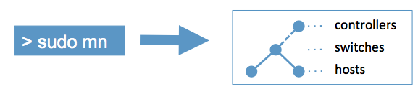
MININET - INTRODUCTION
Mininet creates a realistic virtual network, running real kernel, switch and application code, on a single machine (VM, cloud or native), in seconds, with a single command
Virtual test bed and development environment for SDN

Slide 16
Download/Get Started With Mininet
Download a pre-packaged Mininet/Ubuntu VM - Linux Kernel
Mininet VM Installation (easy, recommended)
Download Mininet VM image.
Download and install a virtualization system. VirtualBox or VMware Workstation
Run through the VM Setup Notes to log in to the VM and customize it as desired.
Follow the Walkthrough to get familiar with Mininet commands and typical usage.

Slide 17
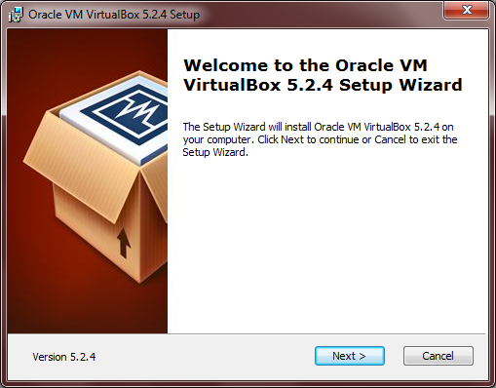
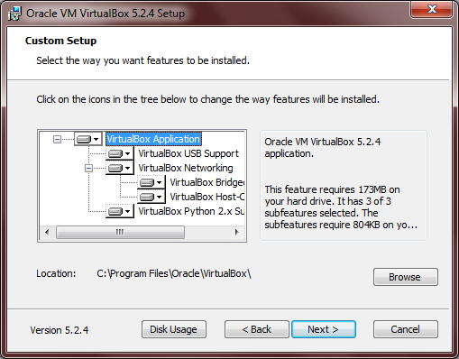
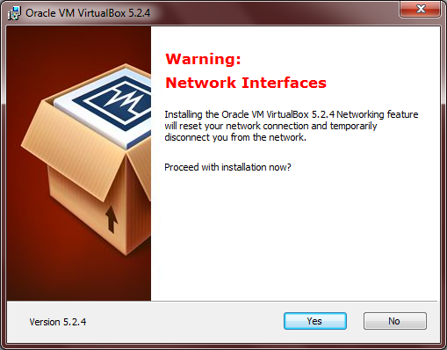
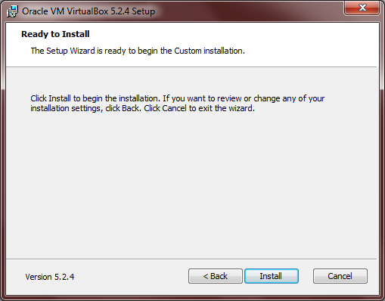
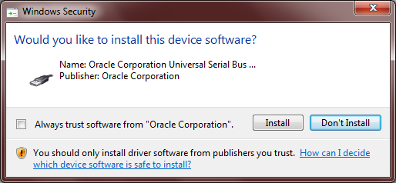
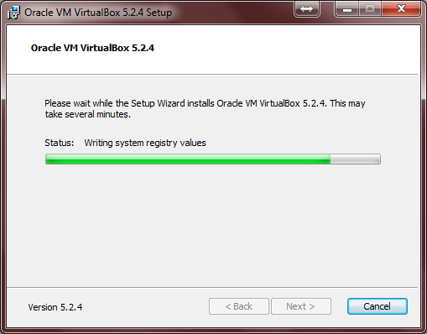
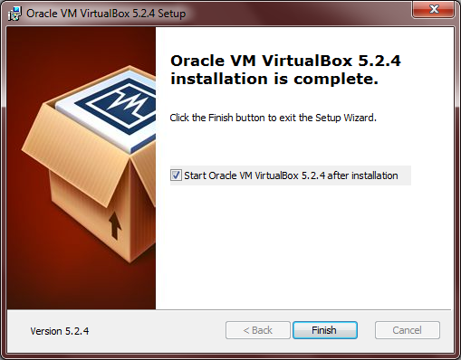
1
2
3
5
6
4
7
INSTALL VIRTUALBOX

Slide 18
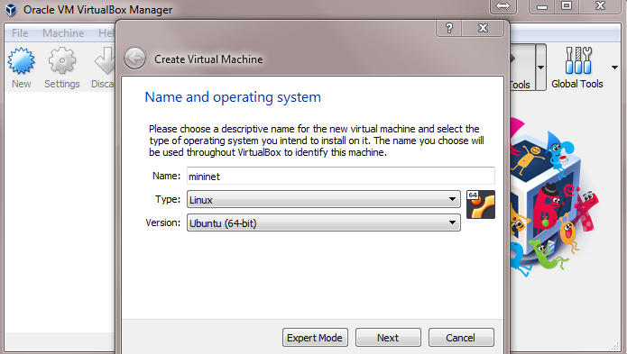
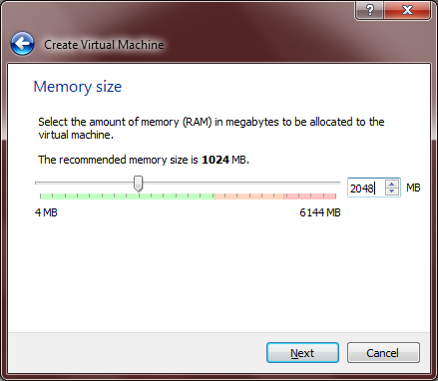
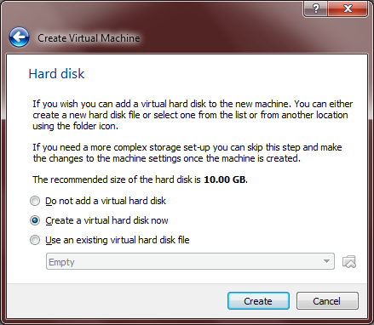
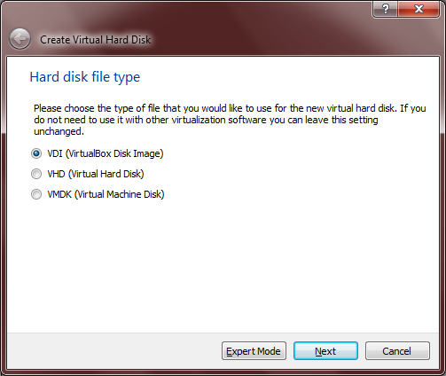
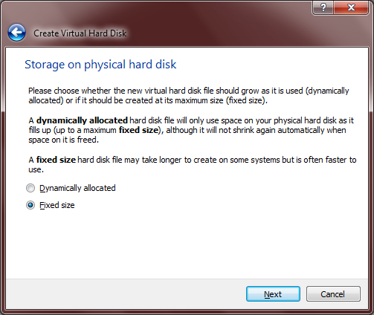
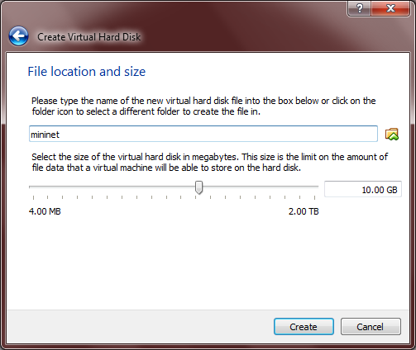
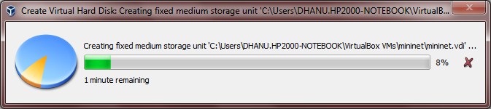
10
8
9
11
12
13
14

